Slide 1
Supervised Learning Unit 3 Capstone
By Grace Flynn

Slide 2
Purpose And Target
If we examine a city’s health behaviors and disease proportion, can we estimate the percentage of people with/without health insurance?
Target Variable = Percent of People with Access to Healthcare

Slide 3
Terms
Comorbidity – when two or more illnesses are found together
Depression and anxiety are a common example of this
Access – access to healthcare can be measured by a number of things, but this analysis defines it as not having health insurance
PCP – Primary care physician

Slide 4
500 Cities CDC Dataset – What’s in it?
Measures:
Unhealthy behaviors
Health Outcomes
Items that could prevent health problems
How
Uses information from CDC Behavioral Risk Factor Surveillance System, the 2010 census, and American Community Survey estimates
Estimates are used from a combination of multi-level regression & poststratification (MRP), geocoded health surveys, and socioeconomic data.
www.cdc.gov/500cities/methodology

Slide 5
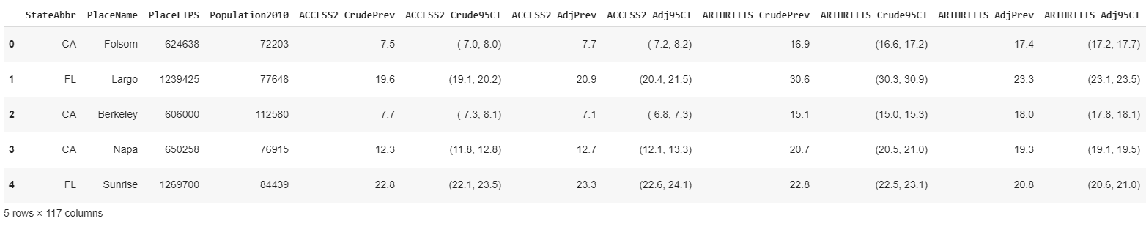
Exploratory Data Analysis
-Three different measurements for each variable:
Crude
A 95% confidence interval
Adjusted

Slide 6
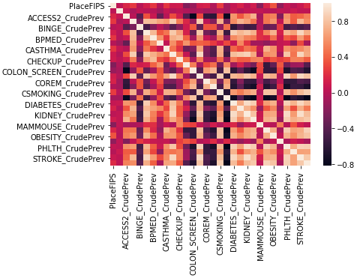
Correlation check
Highly correlated items
Need to be dropped to avoid multicollinearity
Method used: anything >=.6 dropped

Slide 7
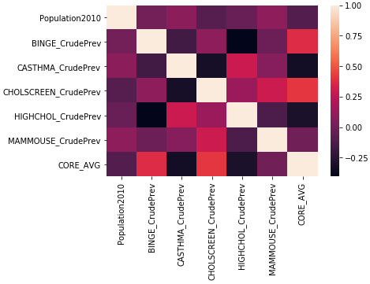
(df.drop it like it’s hot)
Before dropping
After dropping
Hot like a heat map

Slide 8
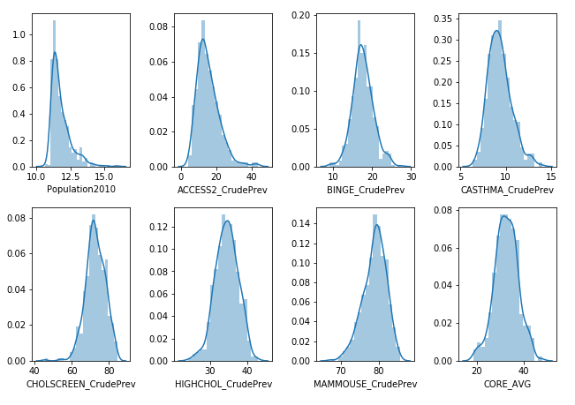
7 Features

Slide 9
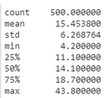
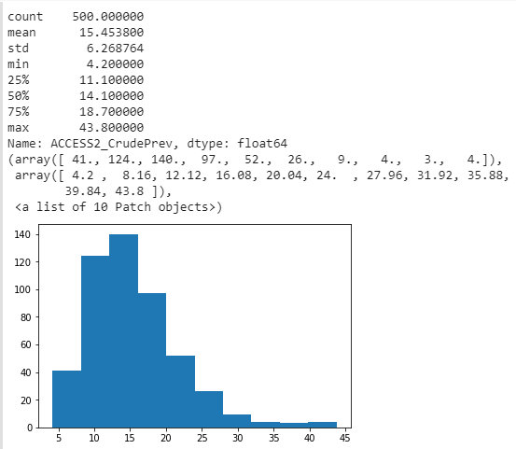
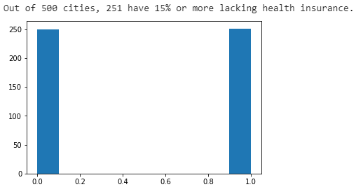
Dependent Variable Transformation
Below the median = low-risk
Above the median = hi-risk

Slide 10
Models and Results
Test Used | CV = 3 Result
Logistic Regression | [0.79041916, 0.83233533, 0.76506024]
Decision Tree | [0.66467066, 0.67065868, 0.6746988 ]
Random Forest | [0.73053892, 0.77245509, 0.76506024]
Random Forest with Grid Search CV | [0.70658683, 0.76047904, 0.70481928]
Gradient Boosting | [0.70658683, 0.74251497, 0.71686747]

Slide 11
Best Model for classification by r²
Test | Train Score | Test Score | CV=3
Logistic Regression | 0.806 | 0.827 | [0.79041916, 0.83233533, 0.76506024]
 | 1 | 0
1 | 61 | 10
0 | 20 | 59
Confusion Matrix score:

Slide 12
Redefine dependent variable…
Below the median = low-risk
Above the median = hi-risk

Slide 13
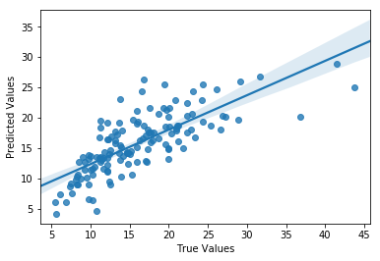
Leave as a continuous variable
Ran PCA (n_components = .80) and then vanilla linear regression:
Train Score | Test Score | CV = 3
0.625 | 0.572 | [0.59025356, 0.61769295, 0.58687229]
Could be improved!

Slide 14
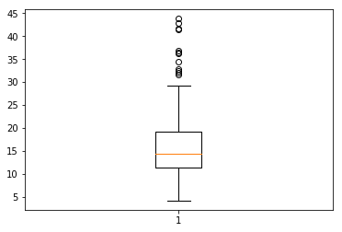
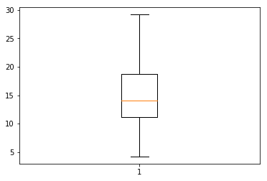
Dealing with outliers…
n outliers = 12
Before:
After:

Slide 15
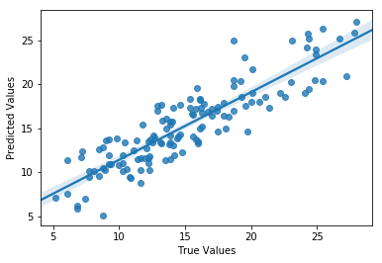
Dealing with outliers…
n outliers = 12
Before:
After:

Slide 16
Last Table
 | Train Score | Test Score | CV = 3
With outliers | 0.625 | 0.572 | [0.59025356, 0.61769295, 0.58687229]
Without outliers | 0.732 | 0.784 | [0.74706727, 0.73632426, 0.74497987]

Slide 17
Assumptions and Weaknesses
CDC made accurate predictions from survey and census data
Poststratification method
CDC accurately corrected for non-response bias
Those severely in poverty and/or afflicted with multiple illnesses are probably more likely to not respond to surveys
The CDC chose 500 cities that accurately represent the US
Lost data in making this a classification problem
Linear regression lost data by removing outliers, but increased accuracy

Slide 18
Further Research
Acquire more data and analyze as time series
Compare data across countries with different healthcare systems

